Slide 1
Introduction to Unity3D

Slide 2
Unity3D Overview
It’s an integrated game developing software with most common features required by games.
It’s fast-to-learn, easy-to-use and has a built-in WYSIWYG scene editor convenient for you to design/debug your game.
You can always check Unity Manual/Reference on Unity’s official site.

Slide 3
Some features of Unity3D
Basic scene editor.
Unity GUI toolkit.
Simple terrain editing.
Physics simulation powered by PhysX.
Lighting/Shadow/Shader support.
Animation/Animator.
NavMesh path-finding.
Optimization Tools.
Scripting using C#.
Etc.

Slide 4
Develop Environment Integration
MonoDevelop (provided with Unity)
Integration plugin that makes Visual Studio work with Unity. (debugging supported as well)
VSTU: Visual Studio Tools for Unity
You can look for proper version and install it.
Some VCS are integrated with Unity. (P4, SVN, etc)

Slide 5
Notes
All words that are formatted like this are type name of UnityEngine’s class/struct.
Screenshots in this presentation are snapshots from Unity 5.2.0f3 (Pro license), actual UI may differ with Unity’s version.

Slide 6
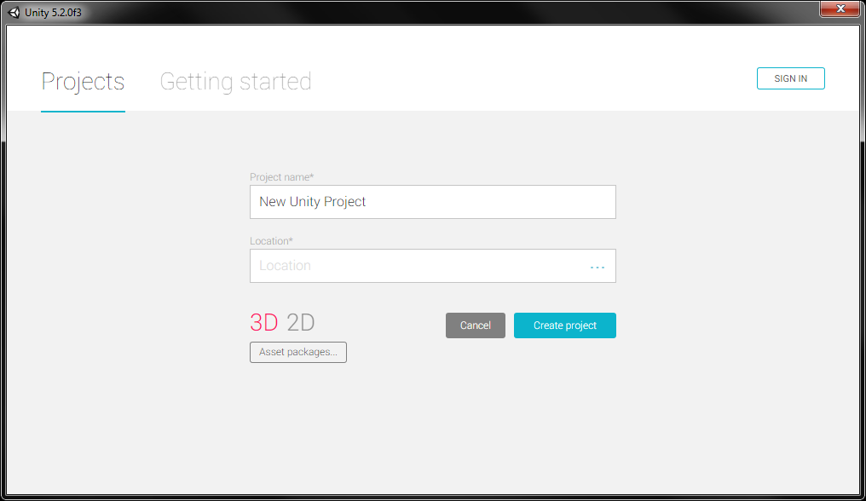
Create a New Project
You need to configure your VCS according to the location of your project.

Slide 7
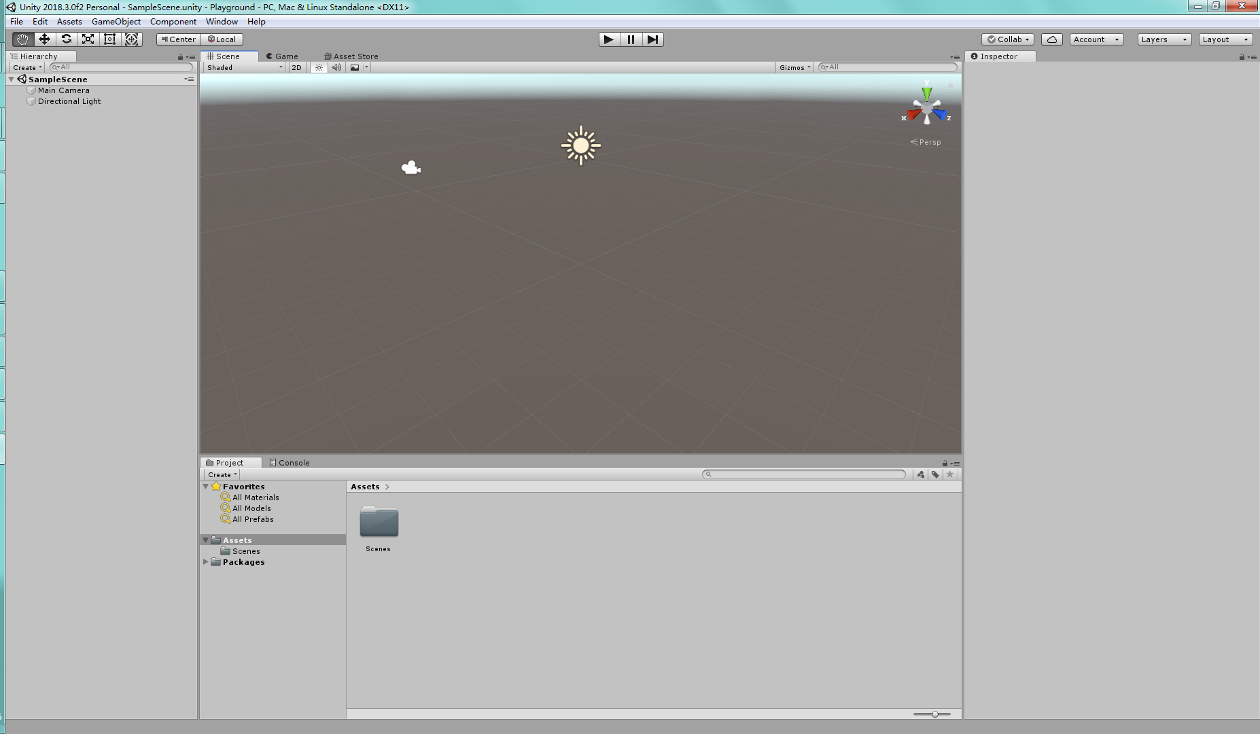
Unity3D Main UI

Slide 8
Unity3D Main UI
Several windows you need to use frequently:
Hierarchy: shows the scene you are editing.
Scene: a 3D view of your scene. You can also move around and drag GameObjects around if you need.
Game: the runtime view of your game. By default, what you see in this view is rendered by the Camera component attached on the “Main Camera” GameObject.
Inspector: shows what Components the selected GameObject has and it allows you to edit properties of them.
Project: shows your project folder structure.
Console: debug/error reporting window.

Slide 9
Structure of Unity Project
Assets
Model/Texture/Sound/TextAsset, etc.
Scripts/Compiled DLL.
Scene
Prefab

Slide 10
Structure of Unity Project
Game
Scene
GameObject
Component
Component
...
GameObject
...
Scene
...
Project Settings
Reference
Art Assets
Script Assets
Plugins

Slide 11
Structure of Unity Project
Scenes and Prefabs are organized in tree structure (Hierarchy). Each tree node in the tree is a GameObject.
Most game logic is implemented as Components and they need to be attached onto GameObjects. Components can have properties and store them.
The most common Component is Transform. Each GameObject has one Transform. It will update the position, rotation and scale of the GameObject it’s attached onto using its own data and all parent nodes’ Transforms.

Slide 12
Structure of Unity Project
Components’ initialization/execution order is arbitrary by default.
If you want to adjust the order, use “Edit – Project Settings – Script Execution Order” and add/edit your component’s order. (Not really suggested though. In most cases, you can avoid doing this by refactoring your codes)
Or you can implement your own update management.

Slide 13
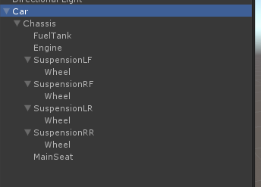
Structure of Unity Project
Example of Hierarchy – Car
Of course it’s a very incomplete car.

Slide 14
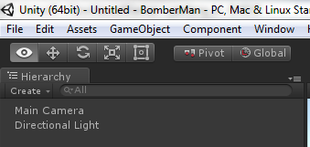
Structure of Unity Project
Scene
Scene is mainly used to design static stages.
You can see the current scene you are editing in Unity3D’s window title. (in this picture the scene is not saved yet, so it’s “Untitled”)

Slide 15
Structure of Unity Project
Prefab
A prefab is also a tree of GameObjects with all Components attached on.
Prefabs can be considered as a template of a complex object.
Example: The car we mentioned in previous page can be stored as a Prefab. We can then Instantiate the car multiple times to get multiple instances (or what Unity calls “clone”).

Slide 16
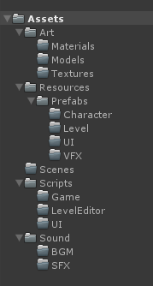
Structure of Unity Project
Example of Project Folder Structure:
Art: All raw art assets go here. Prefabs: All prefabs are stored here. Scenes: All scenes (if there are multiple) go here. Scripts: All codes are inside. Sound: BGM/SFX inside. (This is just an example, you can adjust your folder structure if needed.)

Slide 17
Load Assets during Runtime
Call “Resources.Load(path)” to load assets during runtime.
Unity will search for all folders that are named “Resources”, and try to find that path for each “Resources” folder (if there are multiple).
The Resources.Load(path) function will return the first found asset.

Slide 18
Import Assets
Model (with textures and animations).
Textures for UI Sprites.
.xml/.csv/.txt, etc. as TextAssets for game configurations/data.
Sound for BGM/SFX.
.dll as external library.

Slide 19
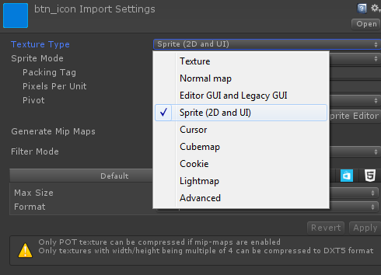
Import Assets
Textures for UI Sprites
You need to modify the import setting of the texture.
Switch to “Sprite”.

Slide 20
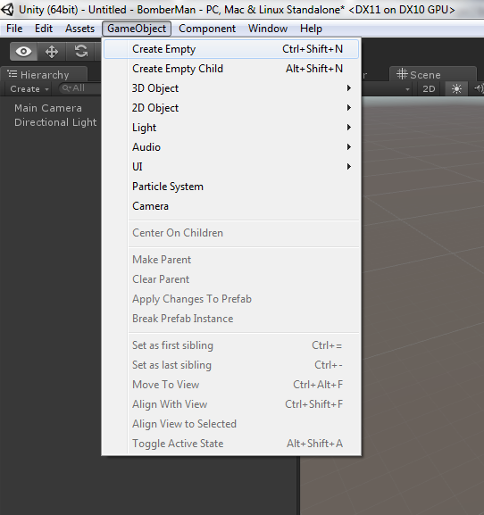
Creating a GameObject
By dragging models into scene.
By creating via Unity “GameObject” menu or right-click menu in Hierarchy window.
You can parent/unparent GameObjects by dragging them onto another GameObject or dragging them between two GameObjects in Hierarchy window.

Slide 21
Creating a GameObject
You can attach either built-in or customized Components onto the GameObject.
Examples of built-in Components: Light, Camera, ParticleSystem, Rigidbody, Collider.
You can write your own customized Component. In most cases, you create it by creating a subclass of MonoBehaviour class.

Slide 22
GameObject’s Layer
Each GameObject belongs to a Layer. By default it belongs to “Default” layer.
You can edit additional layers in “Edit – Project Settings – Tags And Layers”.
What is Layer for?
Camera culling mask.
Physics collision mask.

Slide 23
Creating Your Own Component
MonoBehaviour is a class derived from Component class.
Normally your custom Component should be derived from MonoBehaviour.
Use UnityEngine namespace for convenience.
Several “implicit” function entries of MonoBehaviour:
Awake() Called when the component is instantiated.
Start() Called just before the first update.
FixedUpdate() Called in each physics frame.
Update() Called in each rendering frame.
OnDestroy() Called when the component is destroyed.
OnGUI() Called when Unity engine starts to render GUI.
OnCollision/TriggerEnter/Stay/Exit(), etc. Called when its collider has entered any other collider/trigger volume. For full list of these function entries, read Unity official manual: UnityEngine - Classes - MonoBehaviour.

Slide 24
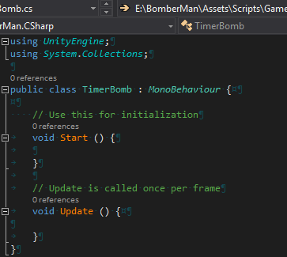
Creating Your Own Component
Example: class TimerBomb
If you create the script file in Unity via right-click menu, these codes will be automatically generated.
NOTE: You should write only one MonoBehaviour class in one script file. And the filename should be same as the class name.

Slide 25
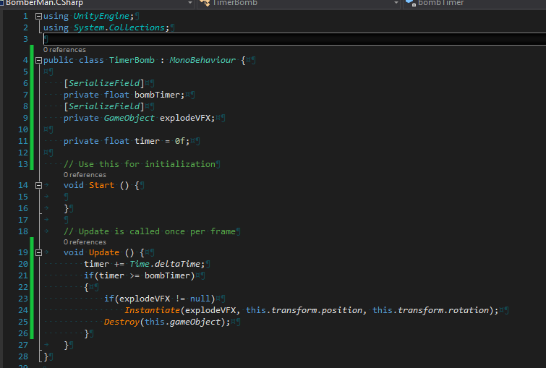
Create Your Own Component
You can add member variables and if supported they can be displayed and edited in Unity’s Inspector window.

Slide 26
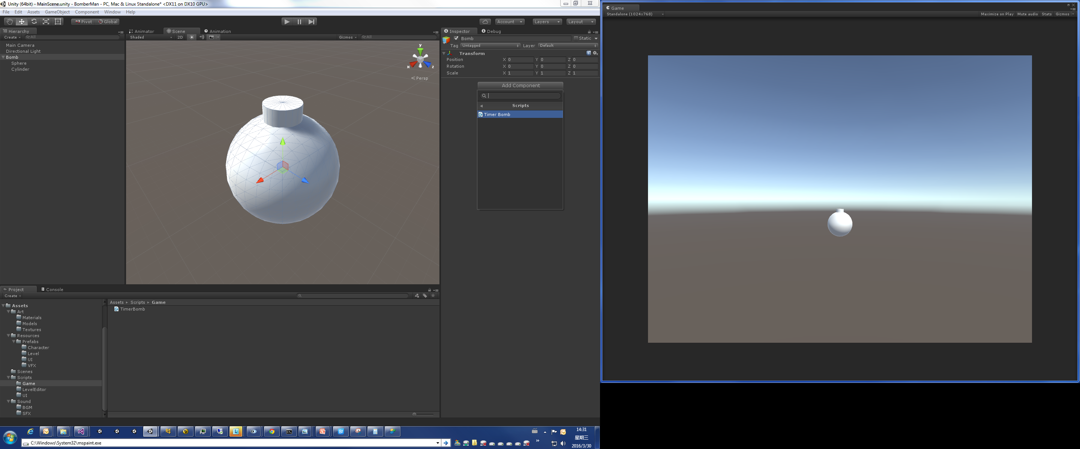
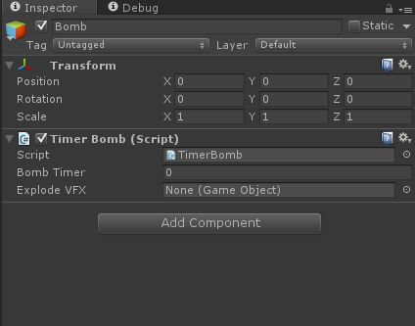
Create Your Own Component
Add your custom component and it will be shown in Inspector window.
Public/serialized private variable will be shown in Inspector if its type is supported by Unity.
Supported types are:
Most basic value types: int, float, double, etc.
Some basic collection types: array of T, List<T> if T is supported.
Some types provided by Unity like Vector2/Vector3/Vector4, Color.
All Component derived classes.

Slide 27
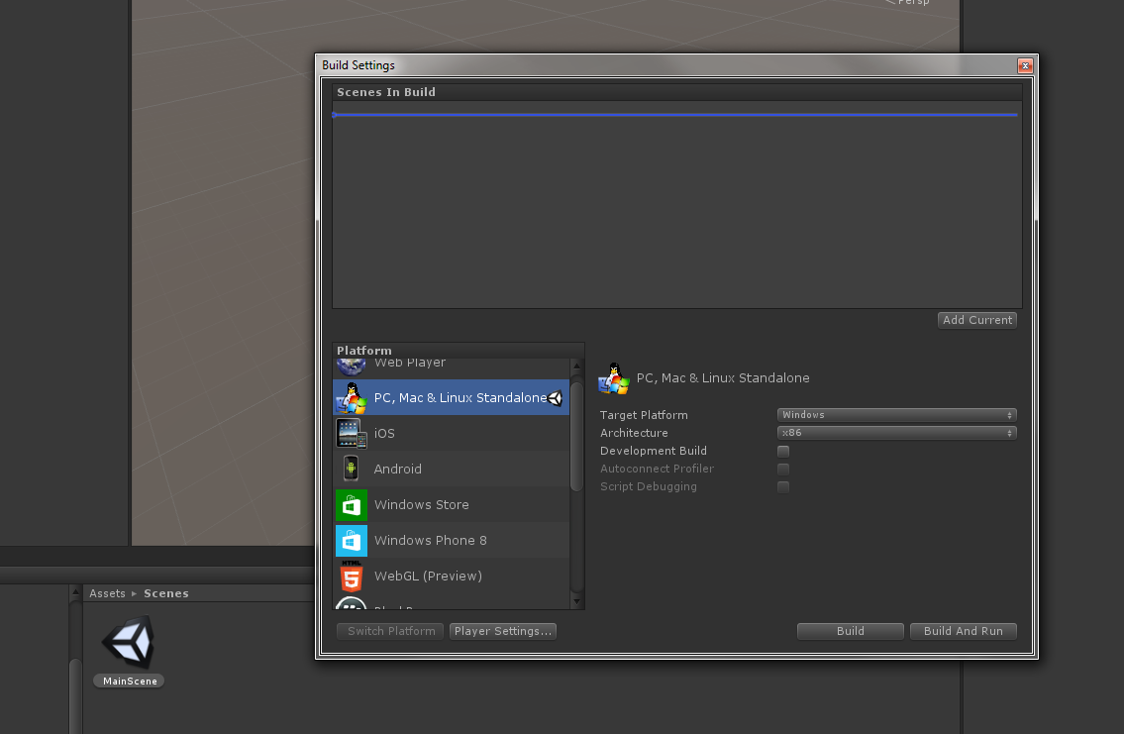
Creating/Using Scene
You can create scene by adding GameObjects into the scene.
Do NOT edit scene in running mode.
Save your scene into proper location with proper filename.
Make sure your scene is registered in “File – Build Settings” window.
You can then load another scene by calling “Application.LoadScene(...)”.
NOTE: Use “File – Save Scene” to save your scene regularly, or you might waste your effort if Unity crashes.

Slide 28
Creating/Using Prefabs
To create a prefab, you can either:
Create an empty prefab via right-click menu in Project window.
Drag a sub-tree in Hierarchy window to the Project window. (which are more commonly used)
NOTE: Use “File – Save Project” (NOT Ctrl+S) to save your prefab changes regularly, or you might waste your effort if Unity crashes.

Slide 29
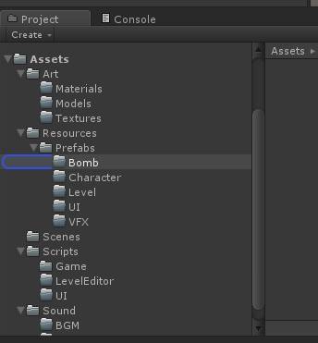
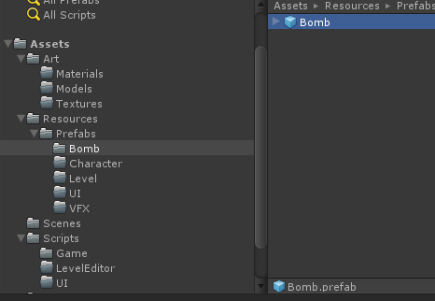
Creating/Using Prefabs
Drag the sub-tree of “Bomb” to the proper folder in Project window.

Slide 30
Creating/Using Prefabs
If you want to edit a prefab:
Double click the prefab in the Project window to enter the edit mode for the prefab.
Edit the instance.
Click “Back” icon at the top of the Hierarchy window to apply the changes to the prefab.
NOTE AGAIN: Don’t forget to click “File – Save Project” to request Unity to flush the changes into hard drive immediately.

Slide 31
Creating/Using Prefabs
To use a prefab, you can:
In editor mode: drag the prefab into the scene.
During runtime, by code:
First acquire a reference to the prefab:
Setup a reference to the prefab in Component.
Call Resources.Load(path relative to “Resources” folder) to acquire during runtime.
Instantiate a new instance(clone) of that prefab:
Call Instantiate(reference of prefab).

Slide 32
UI
Unity provides built-in GUI system.
Legacy GUI (only use it for debugging/editor GUI)
UGUI
Canvas, CanvasScaler
AspectRatioFitter
RectTransform
Image
Text
Button
Toggle
Scrollbar
Mask
Layout Related Components
Etc.

Slide 33
UI: RectTransform
This Component is mainly used to design UI that can react to different resolution/aspect ratio of screen.
Two key concepts:
Anchors & Offsets
Pivots

Slide 34
UI: Layout
Layout Container:
Horizontal/VerticalLayoutGroup
GridLayoutGroup
LayoutElement
Describe how each element should be resized.

Slide 35
Input
Unity provides support to normal mouse/keyboard input and multi-touch tracking on mobile devices.
Unity allows you to define virtual axes with keyboard/mouse/joystick input in Edit – Project Settings - Input.
Common Usages:
Input.GetAxis(axisName)
Input.GetButton/GetButtonUp/Down
Input.GetMouseButton/GetMouseButtonUp/Down
Input.GetKey/GetKeyUp/Down

Slide 36
Input
Input events in UGUI:
OnPointerUp/Down/Click/Enter/Exit
OnBeginDrag/OnDrag/OnEndDrag/OnDrop
Etc.
For more details, check Unity Manual – Scripting – Event System – Supported Events.

Slide 37
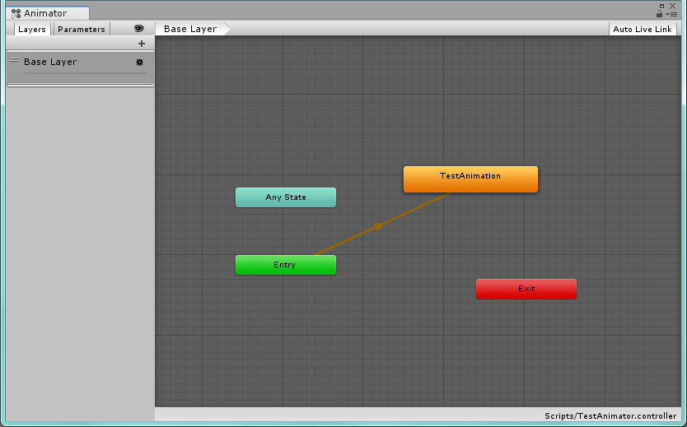
Animation
Unity provides Finite-State-Machine based animator.

Slide 38
Animation
Unity provides parameterized animation control mechanism.
Allows you to program how animation state is switching and how multiple animations are blended and merged together.

Slide 39
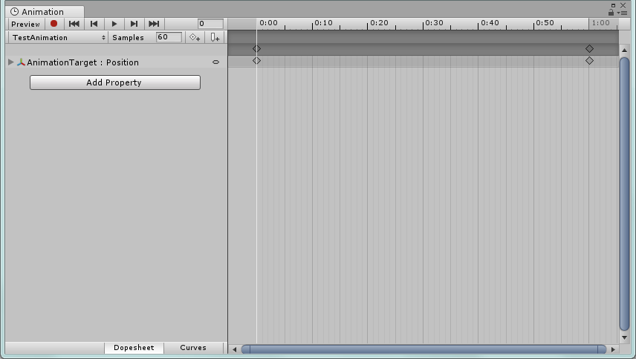
Animation
Unity provides a built-in curve editor for tweaking animation manually. (Example: can be used to make simple UI animation)

Slide 40
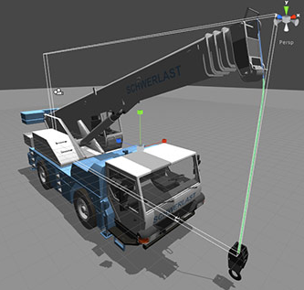
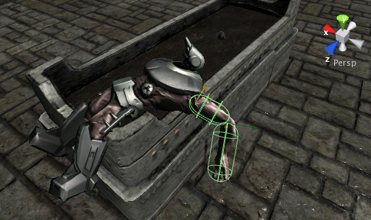
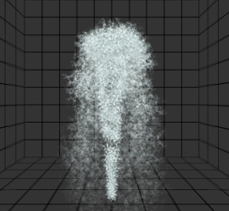
Physics
Unity provides rigid-body simulation, including translation and rotation, velocity and acceleration, force and torque, gravity, windzone, etc.
Unity supports a variety types of joints. (including ragdoll effect)

Slide 41
Physics
Collider
Collision
Objects will bounce when colliding each other.
Trigger
Mainly for game logic. Example: A trap that gets activated when player enters certain area.
Layer Collision Matrix
Defines whether objects of each two layers can collide with each other.
Can be edited in “Edit – Project Settings – Physics”.

Slide 42
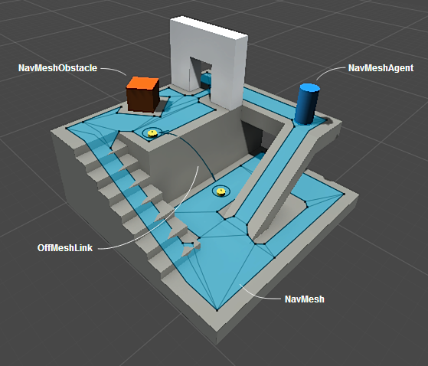
Pathfinding/Navigation
Unity provides a NavMesh based pathfinding solution, which requires baking the scene in advance. (in Navigation window you can bake the NavMesh)
NavMesh
NavMeshAgent
NavMeshObstacle
OffMeshLink

Slide 43
Pathfinding/Navigation
Unity doesn’t support runtime baking of NavMesh in official build.
You may need to get https://github.com/Unity-Technologies/NavMeshComponents for runtime baking if you have procedural-generated maps.

Slide 44
Pathfinding/Navigation
You can also implement your own pathfinding algorithm if NavMesh cannot satisfy your requirement.

Slide 45
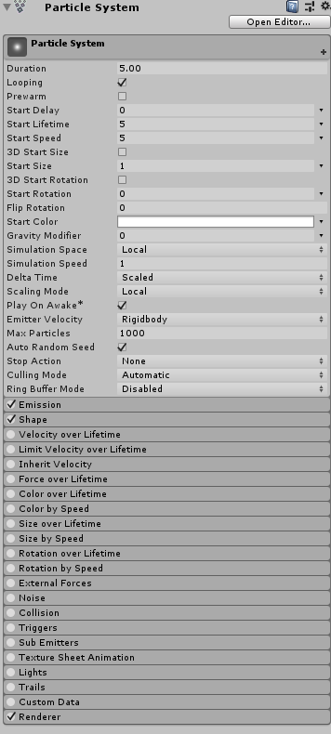
Particle System
Unity provides a complex particle system which can meet requirement in most situations.

Slide 46
Sound
Unity supports simple sound playing as well as 3D sound effect.
AudioSource component decides what AudioClip is to be played and its pitch/volume/attenuation curve.
AudioListener component calculates sound effect (attenuation with distance, doppler effect, etc.) and finally play it out.

Slide 47
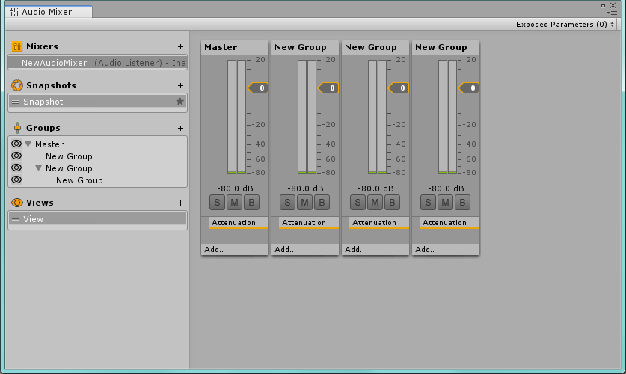
Sound
Unity has also provided filter effects & mixer for sounds. (Not included in this class)

Slide 48
Optimization Tools
A profiling tool that helps you to see time consumption of your codes in each frame.
Find expensive portion of code logic and see if you can optimize.
A frame debugger that can capture the render procedures of a frame.
Allows you to find issues when dealing with complex rendering process.

